Slide 1
NAME : JANAROHITH.V

Slide 2
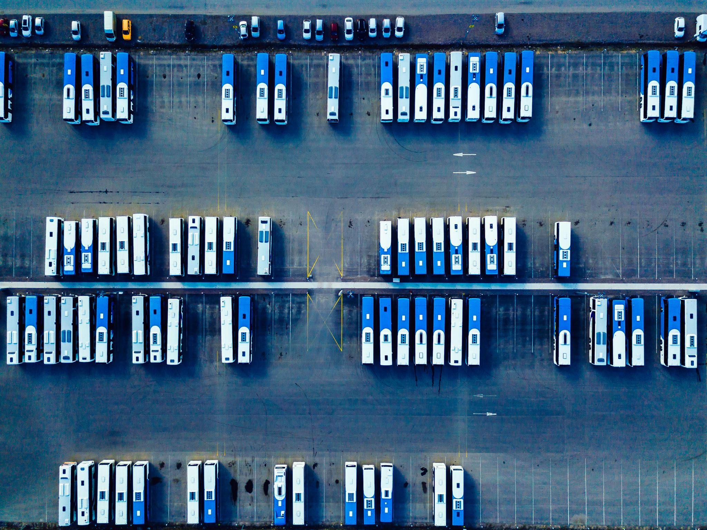
Title: Public Transportation Analysis

Slide 3

Introduction
- Briefly introduce the topic.- Explain the importance of public transportation in urban areas.- State the objectives of your analysis.

Slide 4
Benefits of Public Transportation
- Highlight the advantages of public transportation, such as reduced traffic congestion, lower emissions, and improved accessibility.

Slide 5
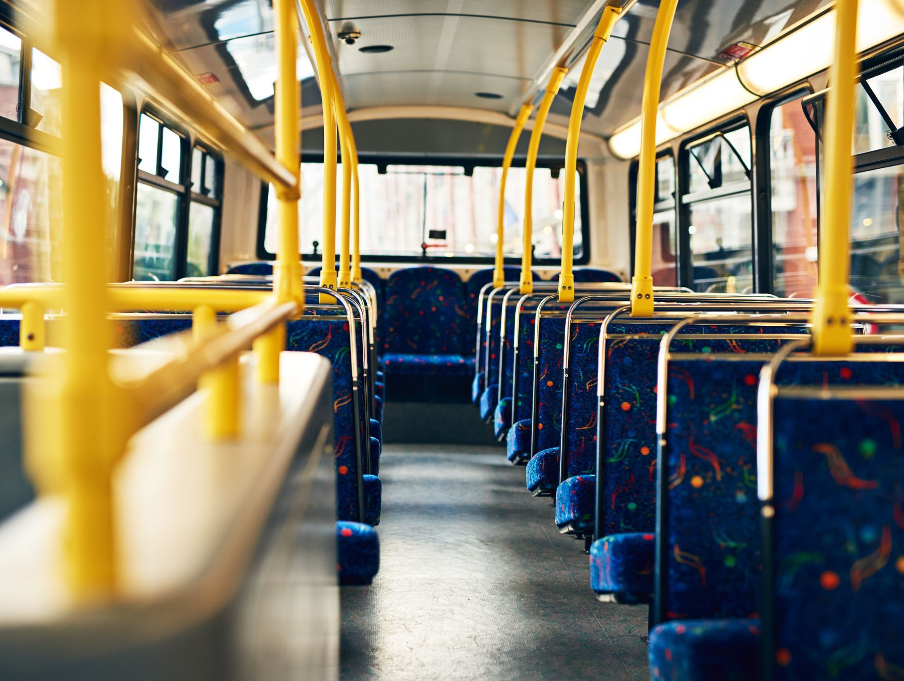
Types of Public Transportation
- Describe different modes of public transportation (e.g., buses, trains, trams, subways, etc.).- Provide examples of each type.

Slide 6
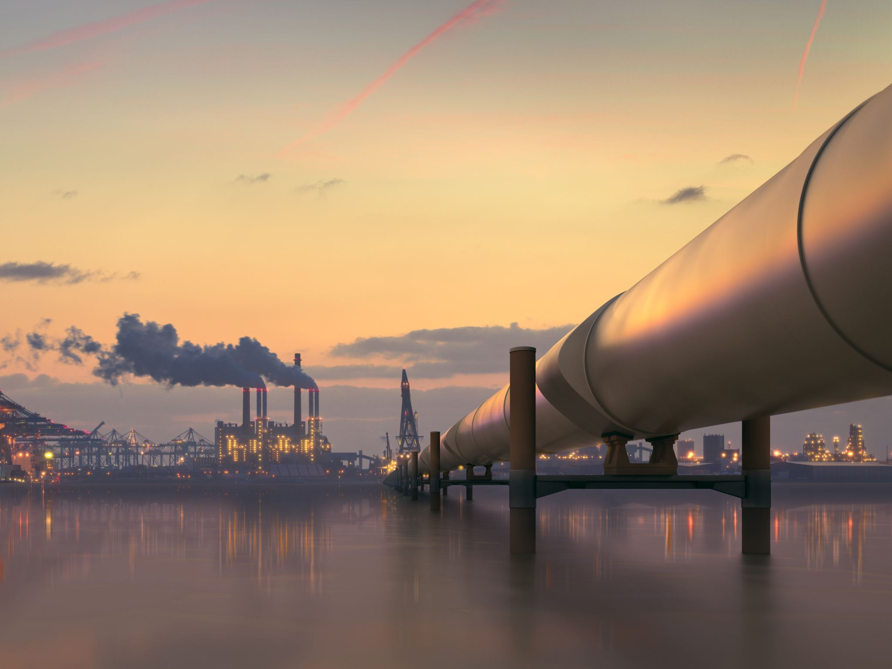
Environmental Impact
- Discuss the environmental benefits of public transportation (e.g., reduced greenhouse gas emissions, air quality improvement).

Slide 7
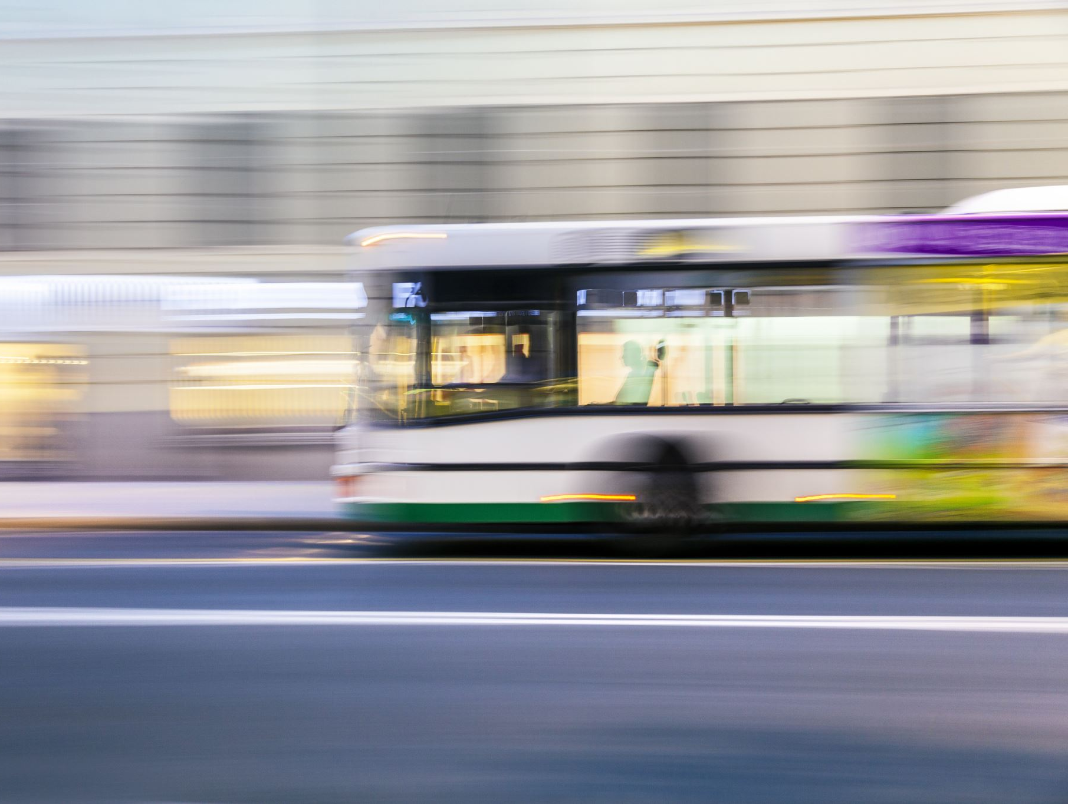
Future Trends and Innovations
- Discuss emerging trends and technologies in public transportation (e.g., electric buses, autonomous vehicles, mobility as a service).
- Mention how these innovations might improve urban mobility.

Slide 8
Public Transportation Challenges in the Future
- Discuss potential challenges that public transportation systems may face in the future (e.g., adapting to new technologies, increasing demand).

Slide 9
Recommendations
- Provide recommendations for improving public transportation in your city or region based on your analysis.

Slide 10

Conclusion
- Summarize the key points of your analysis.- Reiterate the importance of investing in and improving public transportation.

Slide 11

** Thank You**

